Slide 1








I LIKE MODAYS
Unit 3-3

Slide 2


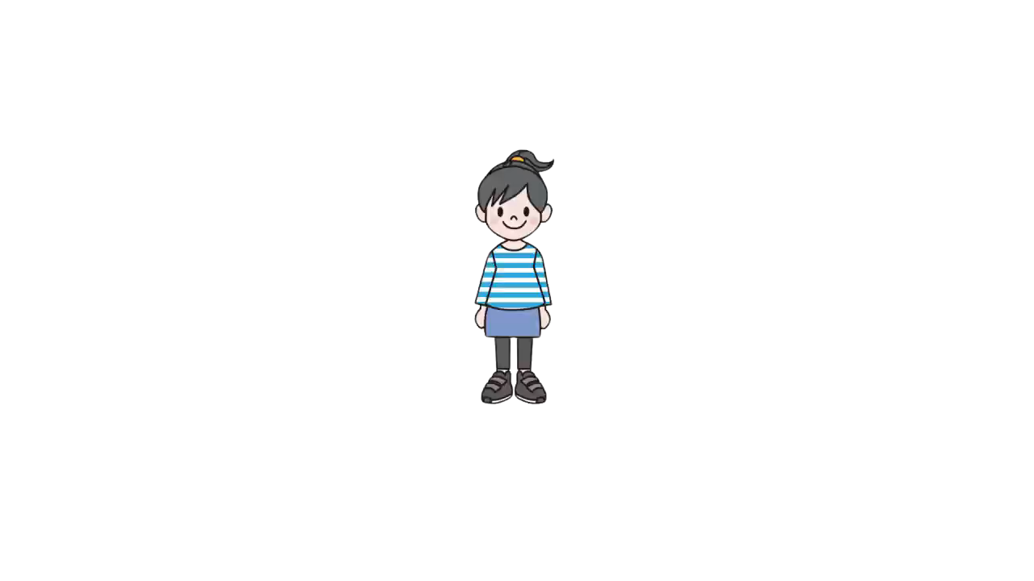


Hello Song

Slide 3
Let’s review
THE DAYS OF THE WEEK !
You can do it !

Slide 4


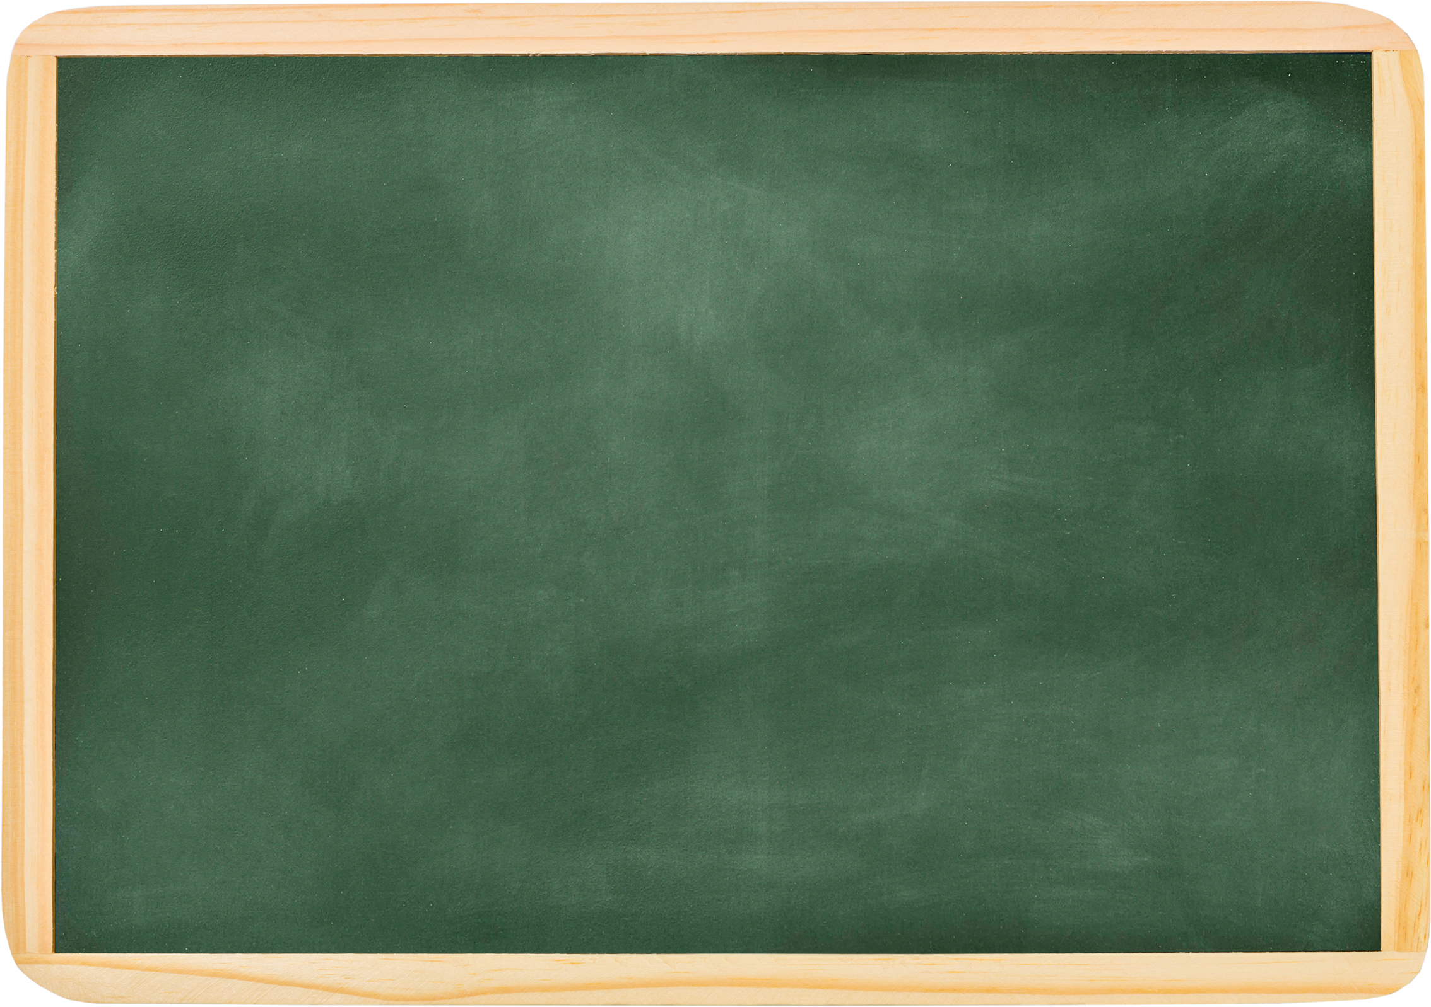

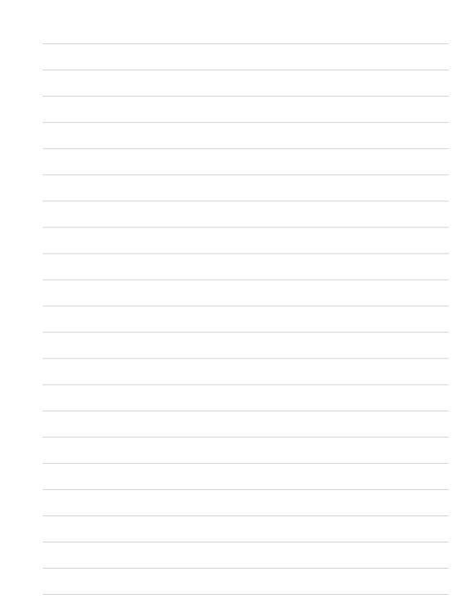





SUNDAY
MONDAY...
a
Tuesday
b
Saturday
?
c
Monday

Slide 5
c
Tuesday

Slide 6





TUESDAY
a
Monday
?
b
Wednesday
c
Friday
THURSDAY

Slide 7
b
Wednesday

Slide 8




THE DAY BEFORE FRIDAY IS...
a
Saturday
b
Thursday
c
Sunday

Slide 9
b
Thursday

Slide 10



THE DAY AFTER THURSDAY IS...
a
Friday
b
Thursday
c
Tuesday

Slide 11
a
Friday

Slide 12






WEEKEND MEANS:
a
Monday&Tuesday
b
Saturday & Sunday
c
Sunday

Slide 13
b
Saturday & Sunday

Slide 14
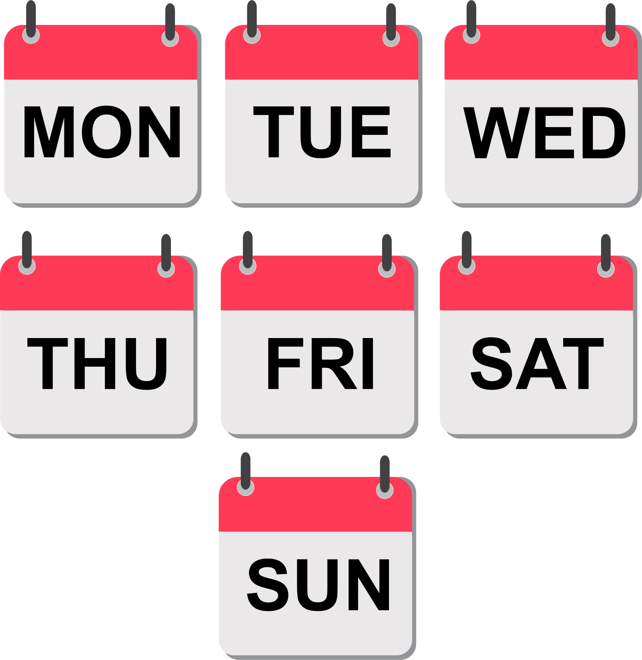
The Days of The Week

Slide 15


Today’s Goal is
What day do you like?
I like (Monday).

Slide 16


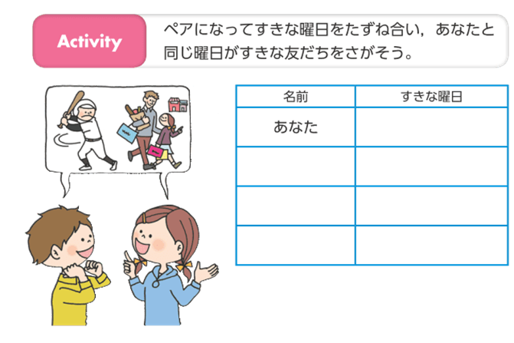
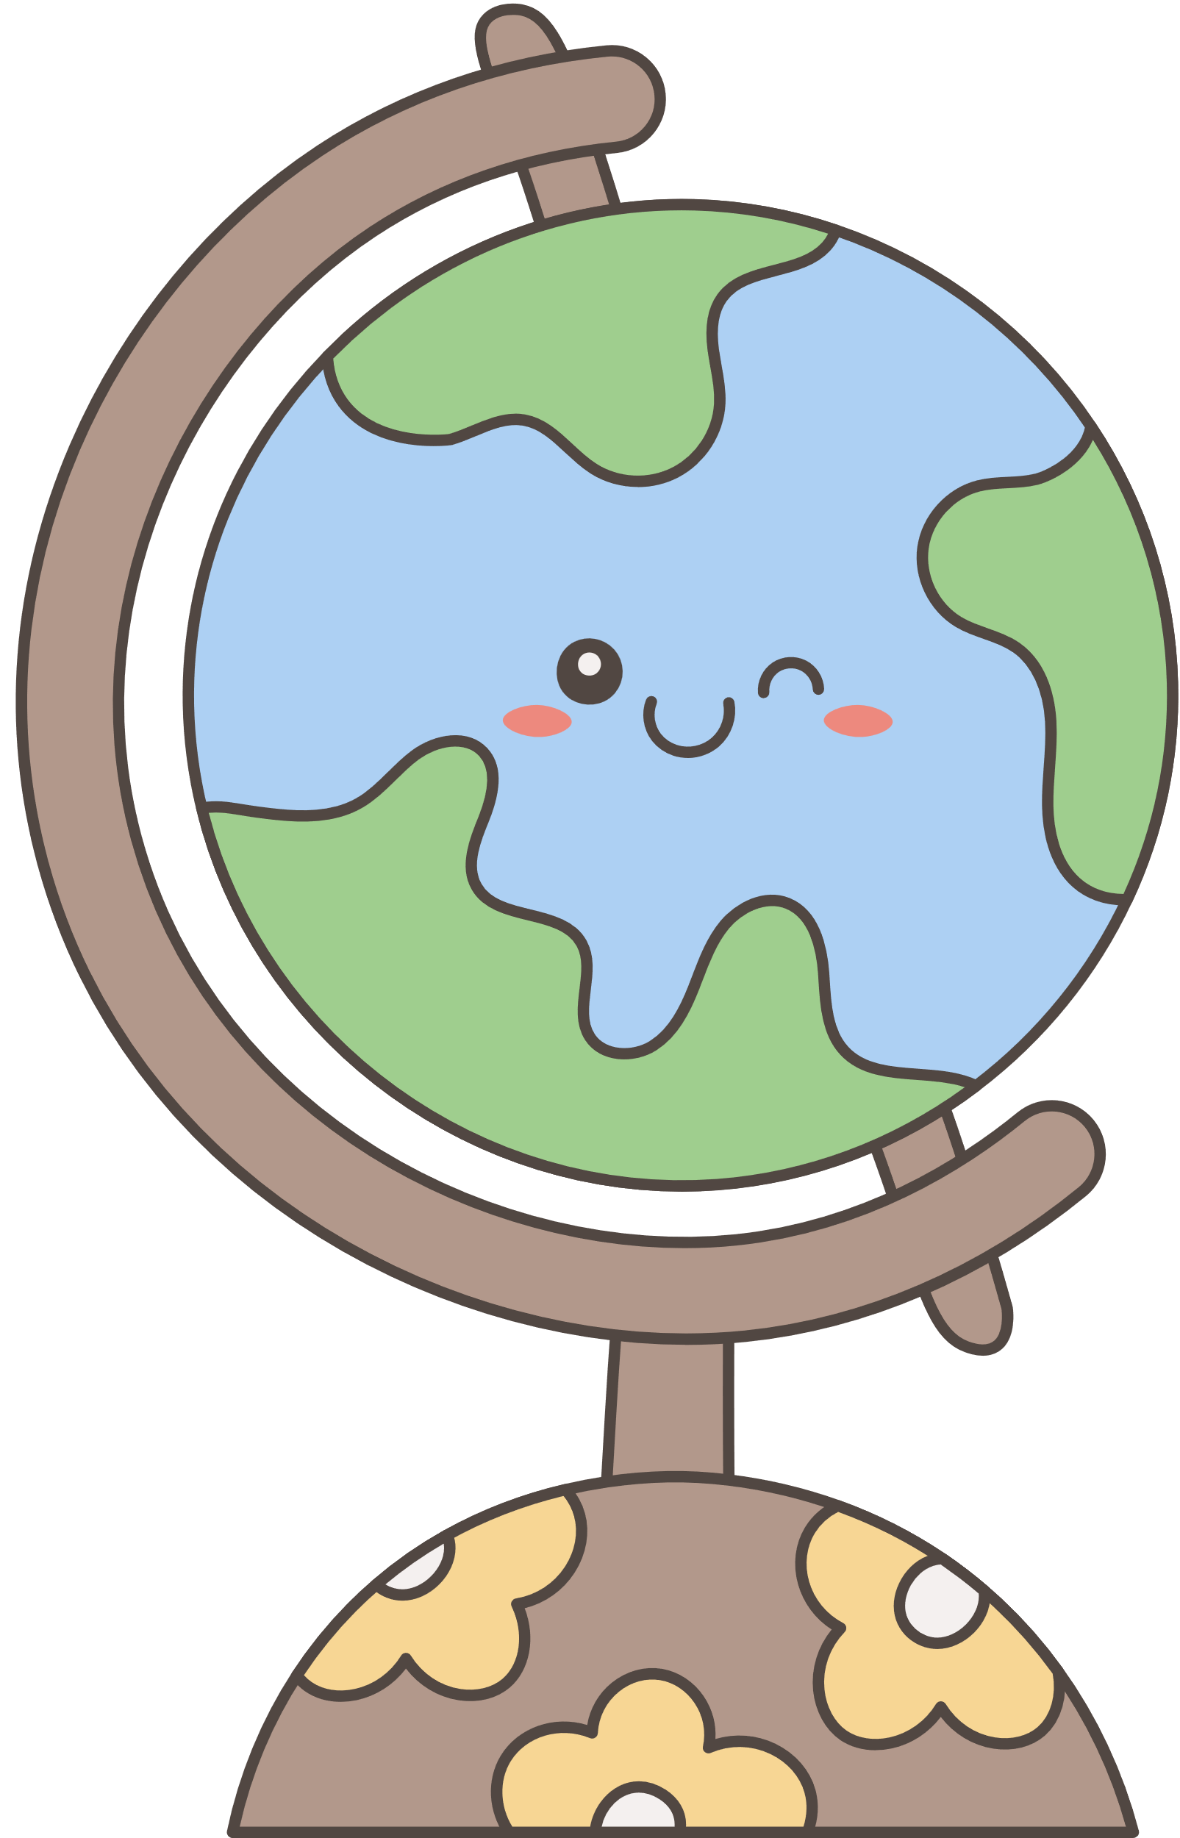

Let’s ask your friends!
What day do you like?

Slide 17
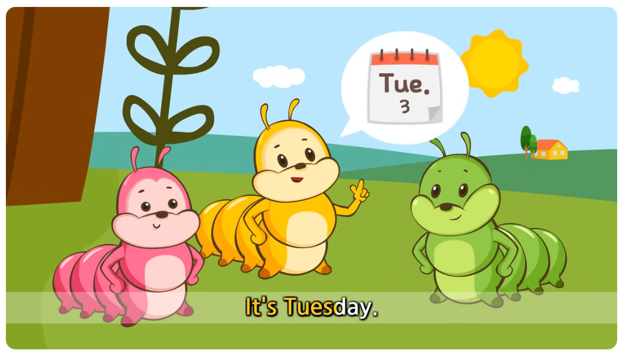

Story time

Slide 18


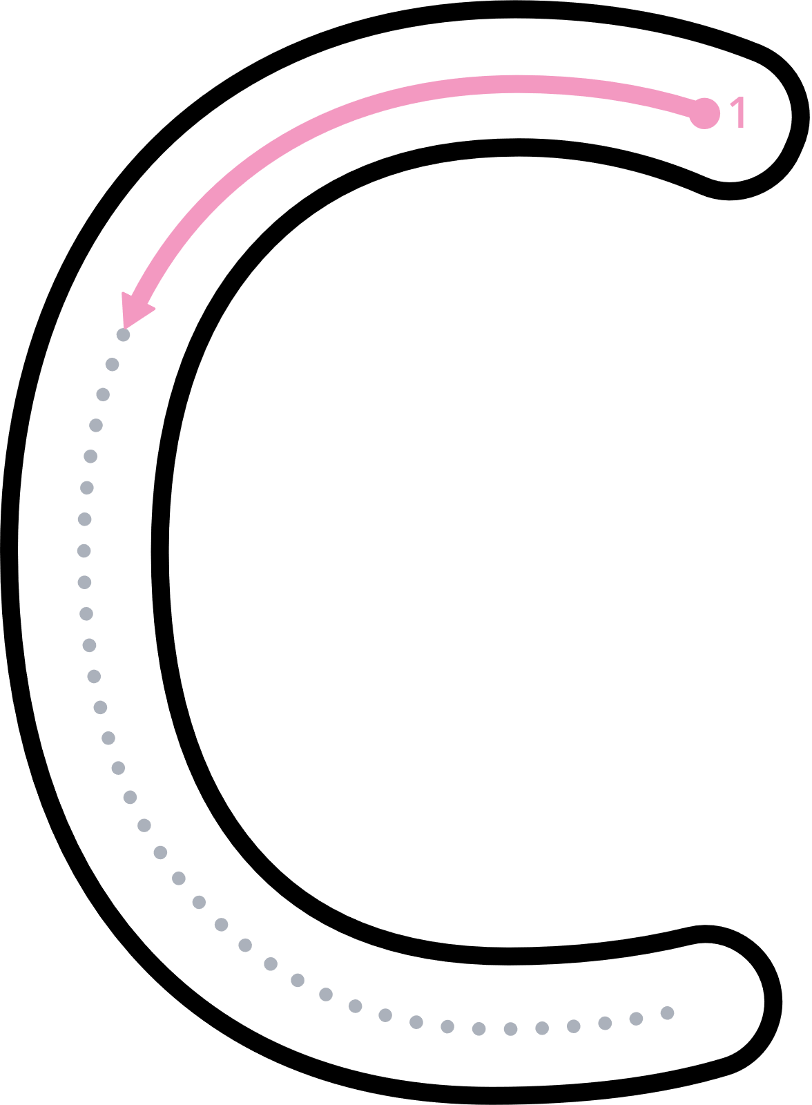

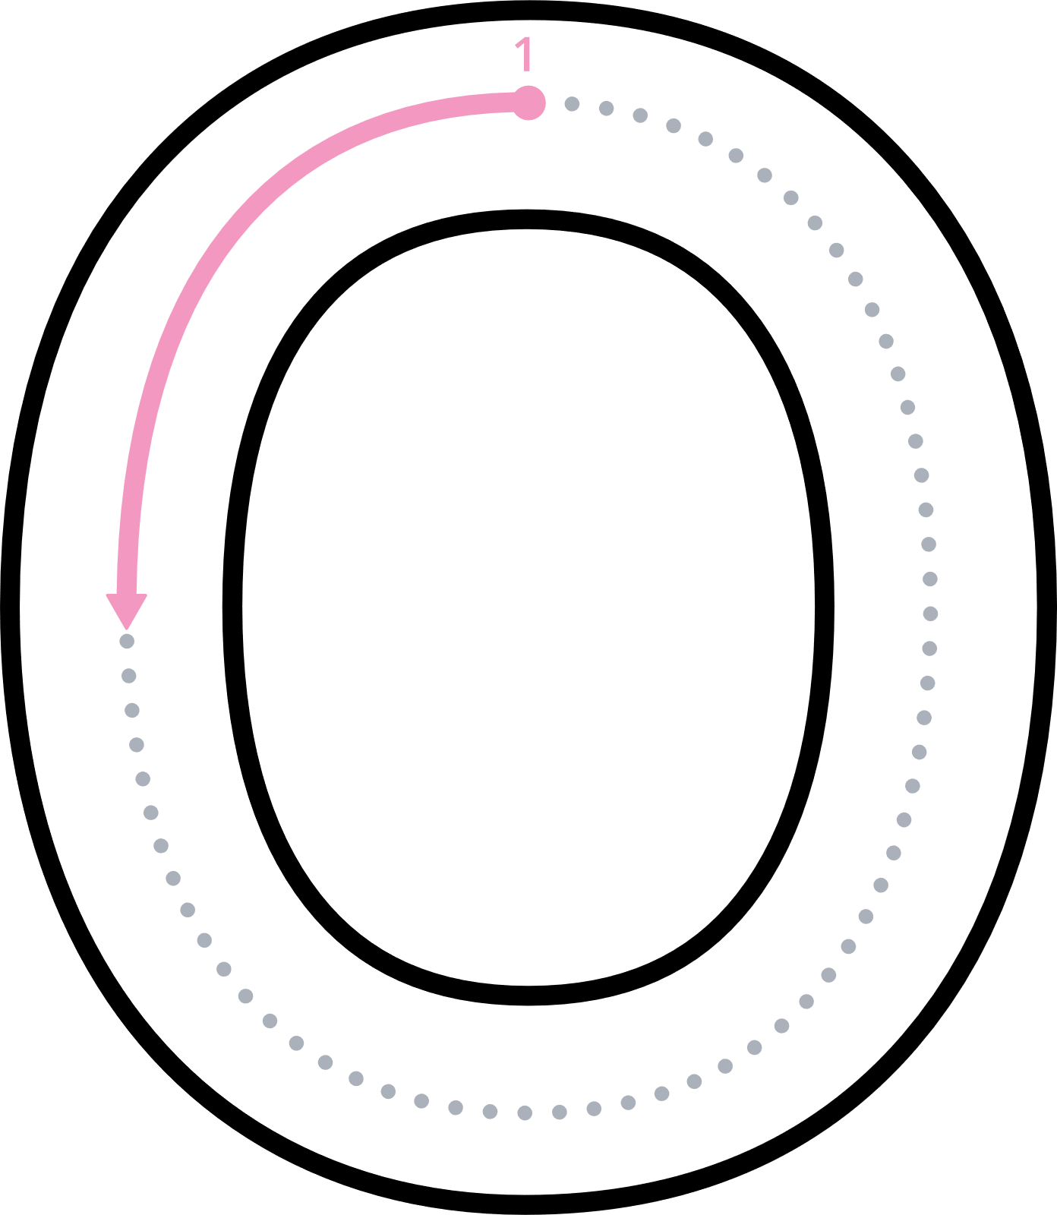

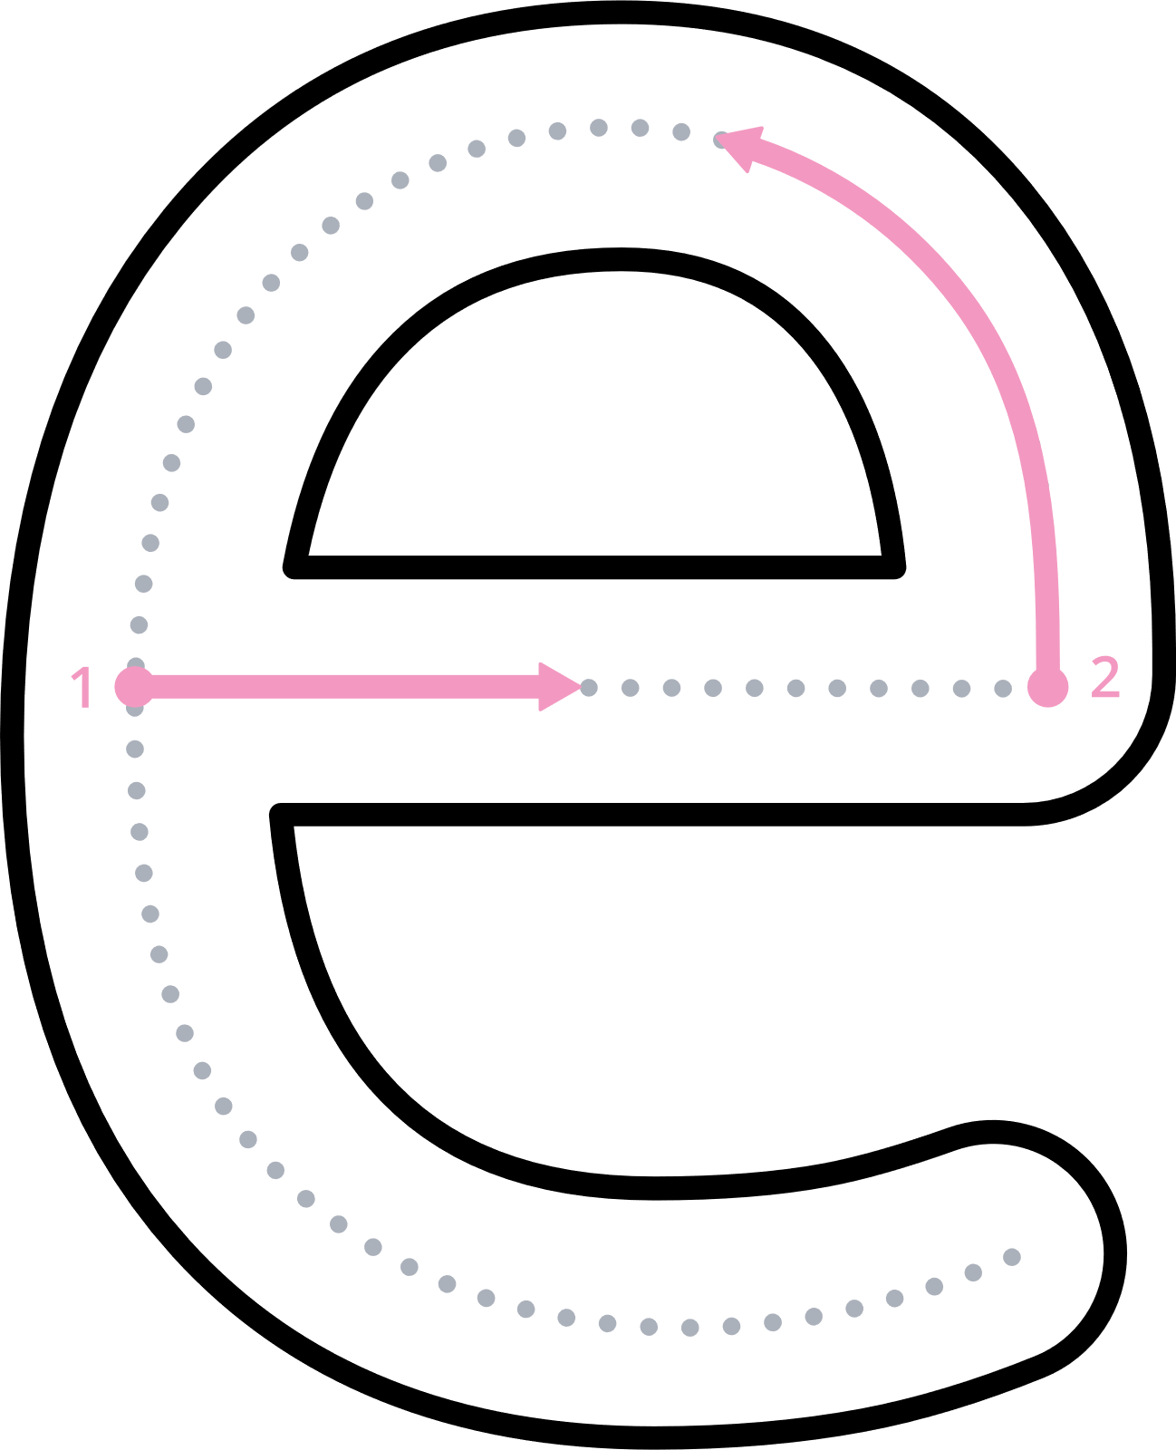
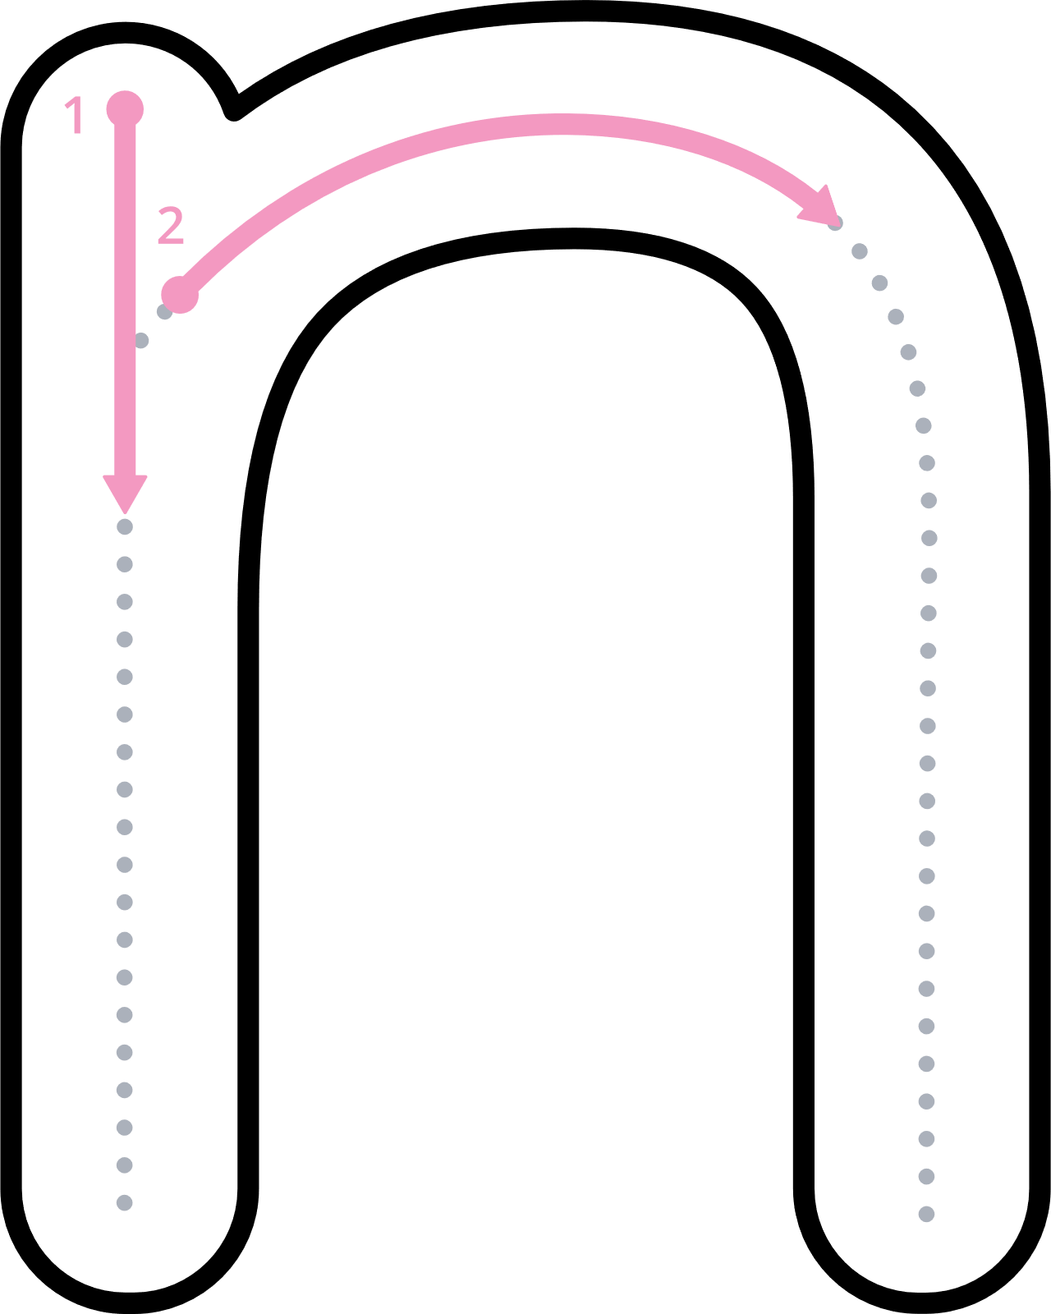
Unit３振り返りをしましょう！
Everyone can succeed!
!

Slide 19
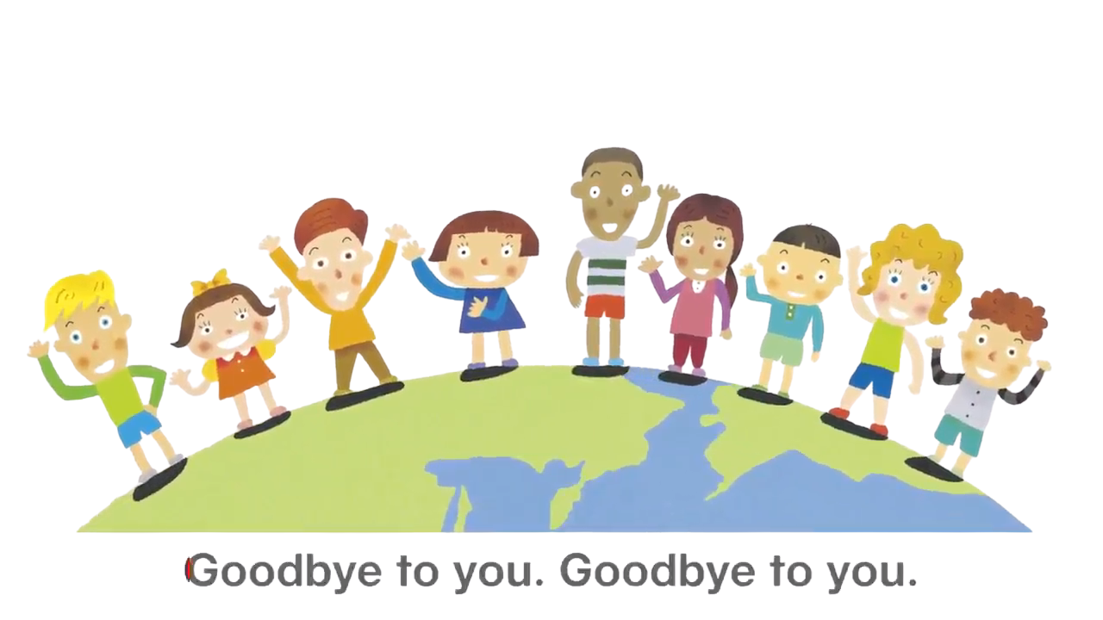
Goodbye Song

